Slide 1
DZS C Embedded Program Course 2023 #DZSCEP20231
C Programming
Basic
Variables - Functions
V1.0.0
Phong Trong Nguyen
C Embedded Trainee
June, 13th 2023

Slide 2

Big-endian & Little-endian
Question:
Data: In computers, binary data is not processed in individual bits, but in blocks of 8 bits, and this smallest unit of processing is called a byte.
For example, a interger 123456789 is represented in binary format would be:
00000111 01011011 11001101 00010101
Write it in Hexadecimal format:
07 5B CD15
To write this data to the hard disk, how is it written? Endianess (specifically little endian and big endian are used).

Slide 3
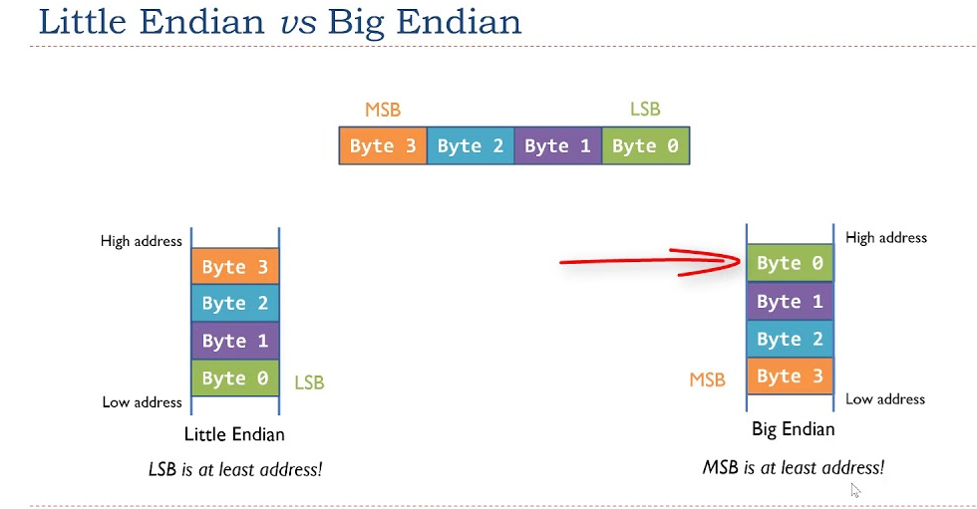
Big-endian & Little-endian
Little-endian Least significant byte stored lowest address Begins by writing the lowest byte to the lowest memory address It matters when you are using type casting Intel, Pentium | Big-endian Most significant byte stored lowest address Begins by writing the highest byte to the lowest memory address Easily check if a number is negative or positive ARM

Slide 4
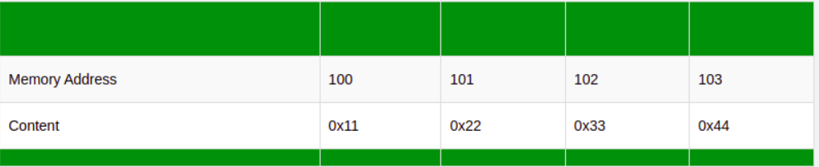
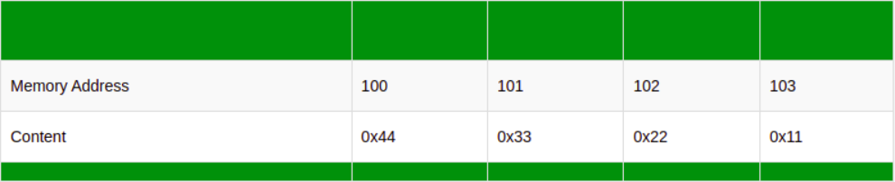
Big-endian & Little-endian
Example: Consider the number 0x11223344.
Now assume that the computer wants to write this number into memory beginning at address 100.
Big endian:
Little endian

Slide 5
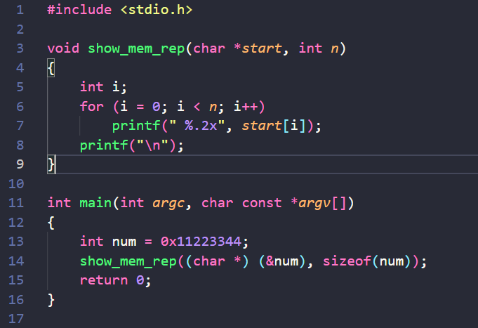
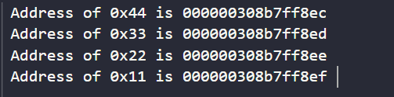
Big-endian & Little-endian
View data bytes in memory
The output: 0x44 (LSB) in the Lowest Address and 0x11 (MSB) in the Highest Address. So this system is the Little Endian System

Slide 6
Big-endian & Little-endian
Endianess depends on Software or Hardware?
All computer operations use binary data, so little endian/big endian is present in all computer operations. Endianess deals with both the software and hardware of the computer system.
Hardware: Endianess depends on the processor architecture of that computer system.
Little endian: Intel, Pentium
Big endian: PowerPC, SPARK
Bi-endian: ARM
Software: Software may also intervene to intentionally use either type.

Slide 7
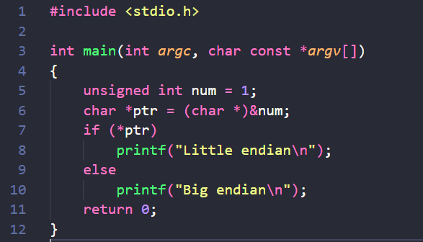
Big-endian & Little-endian
How to determine if a computer uses big endian or little endian
The output ???

Slide 8
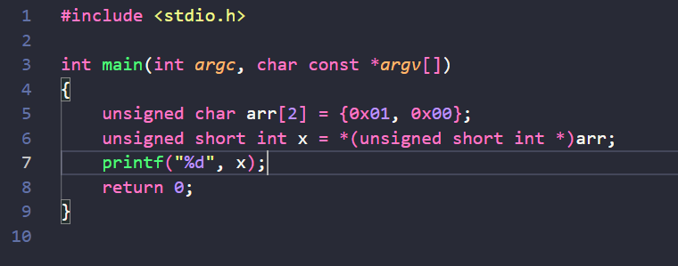
Big-endian & Little-endian
Some cases to notice about big endian and little endian when programming
Issue 1: Transferring data between different computers
NUXI Problem
Issue 2: Type casting variables
The output:
256 if the computer uses big endian
1 if the computer uses little endian

Slide 9
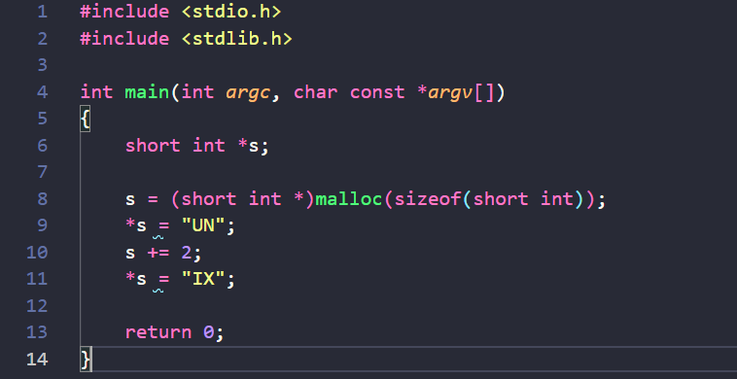
Big-endian & Little-endian
NUXI Problem and Data Transferring between different computers.
NUXI: famous issue involving little endian and big endian
Assume: we need to store 4 bytes (U, N, I, X) using two integers of the form short int: UN và IX (source code)
With the big endian system will store: U N I X
With the little endian system will store: N U X I
The system will help us to automatically process the data reading, so data storing in little or big endian, we take it out we will also get the original data.
However, what if we write this data to a file and transfer it to another computer? Is data exchanged between computers protected?

Slide 10
Big-endian & Little-endian
NUXI Problem and Data Transferring between different computers.
Solution 1: Sử dụng chung định dạng
Một phương án đơn giản nhất tất cả sử dụng chung một định dang khi truyền dữ liệu
Chỉ phù hợp với việc truyền dữ liệu đơn giản từng byte một của file
Đối với truyền dữ liệu trong Internet?
Network Byte Order (big endian)
Big-endian là định dạng phổ biến nhất trong mạng dữ liệu; các trường trong cá giao thức của bộ giao thức Internet, chẳng hạn như IPv4, IPv6, TCP và UDP, được truyền theo thứ tự big-endian.
Tuy nhiên vẫn sẽ có một số giao thức chơi trội, sử dụng little endian
C hỗ trợ một số hàm
hton*: chuyển đổi dữ liệu thành dữ liệu chuẩn theo network byte order
ntoh*: chuyển đổi dữ liệu nhận được từ mạng về dữ liệu máy tính có thể hiểu được.
Solution 2: Sử dụng BOM (Byte Order Mark)
https://viblo.asia/p/little-endian-vs-big-endian-E375z0pWZGW

Slide 11
Control Flow
Question: Why create Control Flow?
When a C program is run, the CPU will start executing instructions at the beginning of main(), execute instructions sequentially from top to bottom, and end the program at the end of main().
Control Flow is responsible for changing the process flow of the program.

Slide 12
Control Flow
Control flow
Conditional or Selection Statements
if
if-else statement
Loop
for
Jump Statements
return
continue
break
goto and labels
while
If-elseif statement
switch-case
do-while

Slide 13
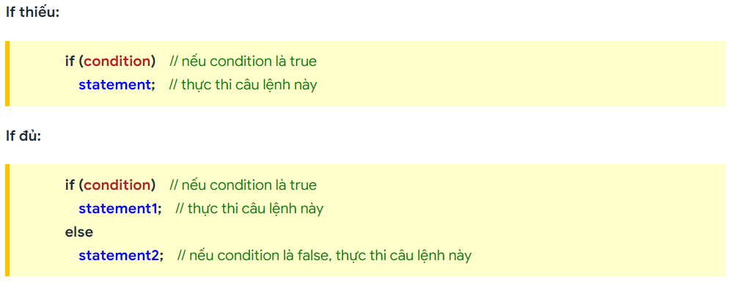
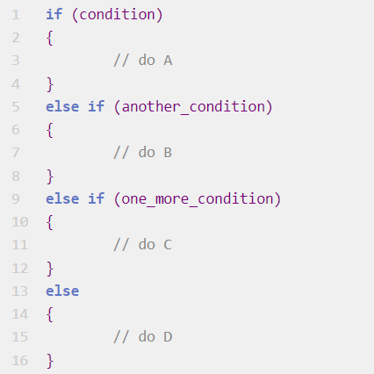
Control Flow
Conditional and Selection Statements
if statement
if-else-if statement (chaining if statements)
if-else statement

Slide 14
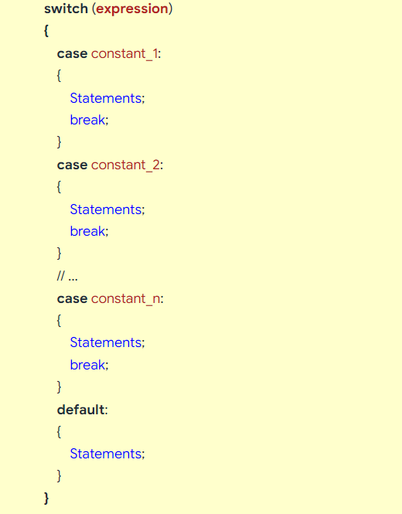
Control Flow
Conditional and Selection Statements
switch statements
Rules of switch statements:
expression: a variable (or expression) with an integer value (char, short, int, long, int32_t, enum, ...).
Case labels: use the keyword case, followed by a constant (integer, character constants or constant expression).
The number of case labels is unlimited, and there are no duplicate cases.
Default label (default label) uses default keyword. If there is no case label corresponding to the value of the switch's expression, the default label will be executed. The default label may or may not have 1.
The break keyword is used to terminate the switch…case . structure.

Slide 15
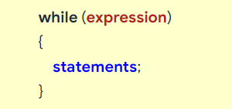
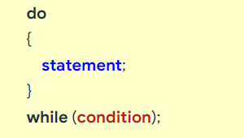
Control Flow
Loop statements:
The loop structure helps the program to repeat a block of instructions until the loop condition is no longer satisfied.
while statements
while loop can be executed multiple times or not executed at all.
do-while statements
do-while loop requires the loop to execute at least once before checking the condition.

Slide 16
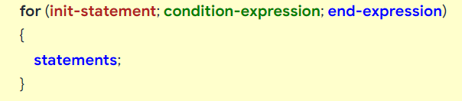
Control Flow
Loop statements:
The loop structure helps the program to repeat a block of instructions until the loop condition is no longer satisfied.
for statements
The operating principle of the for loop consists of 3 execution steps:
init-statement: defining and initializing the variable, which is executed only once in the first iteration.
condition-expression: this section includes conditional expressions, if the conditional expression is true, the statements in the loop will be executed.
end-expression: this is executed at the end of each iteration, after the statements in the for loop are executed. This section usually has the purpose of increasing or decreasing the value of loop variables. After executing, the loop returns to check the loop condition in step 2.

Slide 17
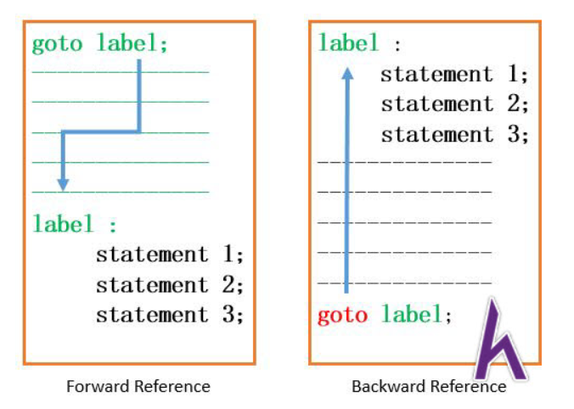
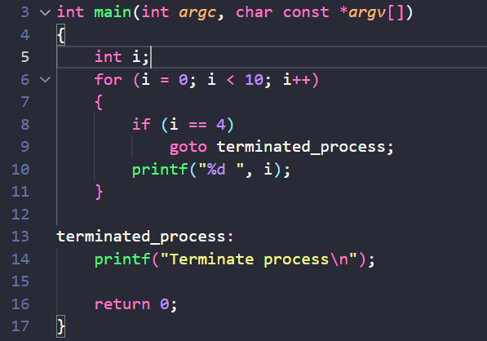
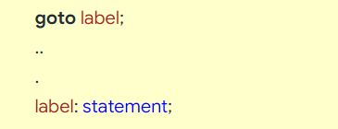

Control Flow
Jump statements:
goto statements
The output:
The goto statement in C provides an unconditional jump from the goto statement to the labeled instruction in the same function.
Disadvantages:
The use of the goto statement is highly discouraged as it makes the program logic very complex.
The use of goto makes tracing the flow of the program very difficult.
The use of goto makes the task of analyzing and verifying the correctness of programs (particularly those involving loops) very difficult.

Slide 18
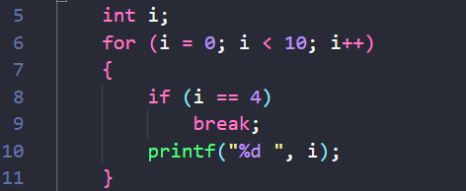
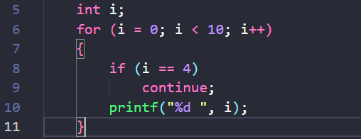


Control Flow
Jump statements:
break and continue statements
The break statement can also be used to jump out of a loop or a switch statements.
The continue statement breaks one iteration (in the loop), if a specified condition occurs, and continues with the next iteration in the loop.
The output:
The output:

Slide 19
Thank you
www.dzsi.com

